Slide 1
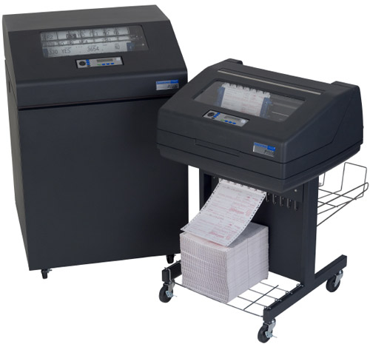
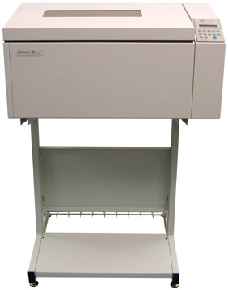
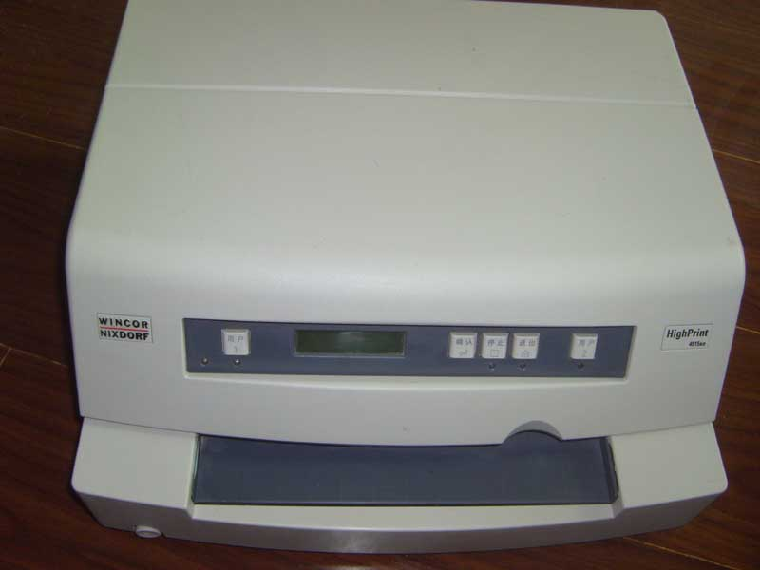
WELCOME TO
PRIMETECH PRINTER SOLUTION PVT.LTD
COMPANY PROFILE
Primetech Printer solution Pvt.Ltd

Slide 2
It gives us a great pleasure to introduce ourselves
AS
PRIMETECH PRINTER SOLUTION PVT.LTD
( One Stop Solution Provider )
Primetech Printer solution Pvt.Ltd

Slide 3
INTRODUCTION
PRIMETECH PRINTER SOLUTION PVT.LTD is conducting its business in the area of printer maintenance. It is providing excellent sales and service support to the users of Line Printers , High Speed Dot Matrix & Passbook Printers.
We cover the complete area of printing solution and provide our excellent service to them.
PRIMETECH PRINTER SOLUTION PVT.LTD right from its existence since has always striven to provide a good support and has always believed in “right thing, first time”, specialization and 100% customer satisfaction are the key buzz words at Primetech Printer Solution Pvt.Ltd.
The company is committed to provide excellent sales and services support to the users of Line matrix printers, High Speed Dot Matrix & Passbook Printers through efficient and motivated team of employees working hard to cater the need of the customer.
Primetech Printer solution Pvt.Ltd

Slide 4
M/S PRIMETECH PRINTER SOLUTION PVT.LTD
Specialization in Line Matrix Printer (LIPI,PRINTRONIX,IBM) ,High Speed DMP & Passbook Printers
Primetech Printer solution Pvt.Ltd

Slide 5
Our Vision and Mission
“Customer Satisfaction”
Work hard to cater the need of the customer
Primetech Printer solution Pvt.Ltd

Slide 6
*Our Goal*
PRIMETECH PRINTER SOLUTION PVT.LTD ultimate goal is to be
“ One Stop Solution Provider ”
Primetech Printer solution Pvt.Ltd

Slide 7

MAIN BUSINESS
ANNUAL MAINTENANCE CONTRACTS
Comprehensive Annual Maintenance Contract for Line Printers(Lipi , Printronix & IBM ) , HSDMP & Passbook Printers.
Primetech Printer solution Pvt.Ltd

Slide 8


MAIN BUSINESS
PRINTERS ON RENT
We provide line matrix , HSDMP & Passbook Printers on Rental basis at your site.

Slide 9

MAIN BUSINESS
CHIP LEVEL REPAIRS
We provide Chip level Repairs of all Line matrix Printer's Circuit boards & Power supply.
We also Provides Print Head Repairs & Refurbishing for high speed DMP’ & Passbook Printers.
Primetech Printer solution Pvt.Ltd

Slide 10
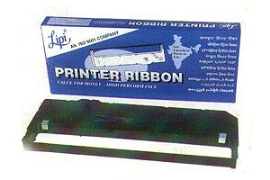

CONSUMABLES
We Provide genuine consumable of Line Printers.

Slide 11
ORGANISATION STRUCTURE
1. Customer support Dept.
2. Marketing Dept.
3. Sales Dept.,
4. TRC Dept,
5. Dept. of Finance
6. Dept. of Technical Support.
Primetech Printer solution Pvt.Ltd

Slide 12
SUMMARY
LEGAL STATUS : PRIVATE LIMITED COMPANY.
SERVICE TAX NO : AAECP657HST001
PAN NO : AAECP6574H
VAT TIN : 27810672537V
CST TIN : 27810672537C
Primetech Printer solution Pvt.Ltd

Slide 13




PARTIAL LIST OF OUR ESTEEMED CLIENTS
Primetech Printer solution Pvt.Ltd

Slide 14




PARTIAL LIST OF OUR ESTEEMED CLIENTS

Slide 15





PARTIAL LIST OF OUR ESTEEMED CLIENTS

Slide 16
END OF REPORT
Sample of diversified client base mentioned above speaks about our Services.
Primetech Printer solution Pvt.Ltd

Slide 17
CONTACT US
202, Veena Industrial Estate
Opp. Everest Masale
L.B.S Marg , Vikhroli (w )
Mumbai – 400 083
Ph: 25792488 / 32639428
Email : helpdesk@primetechsolution.com
sales@primetechsolution.com
Primetech Printer solution Pvt.Ltd

